Slide 1
Diffusion-based Adversarial Training #1
202111259 CSE 김수환

Slide 2

Contents
Diffusion model
Diffusion-based AT
Idea

Slide 3
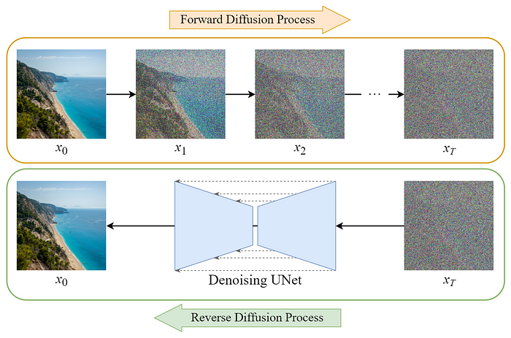
1. Diffusion model - DDPM
→ Reverse Diffusion Process를 T번 진행하여 denoising하는 것을 학습
https://xoft.tistory.com/32

Slide 4
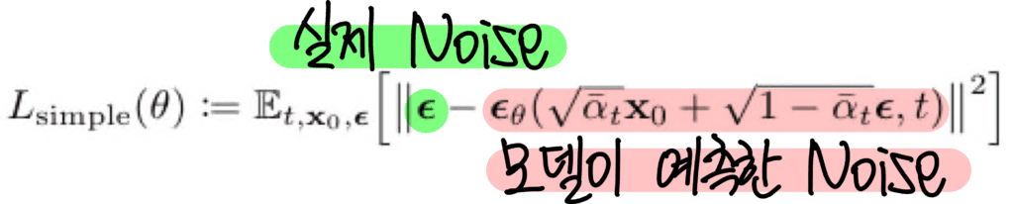
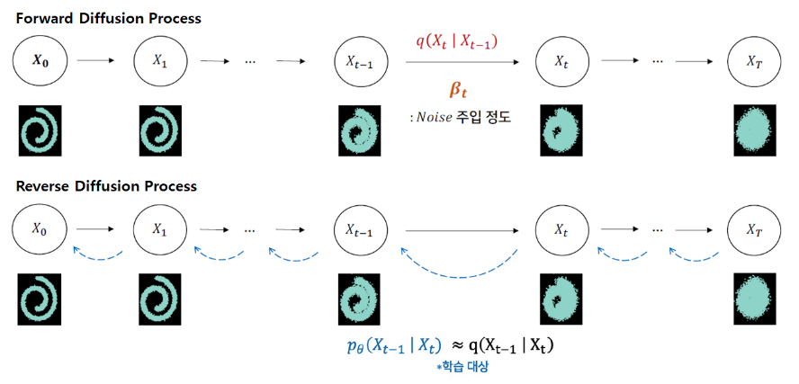
1. Diffusion model - DDPM
단순히 수식으로 진행되는 부분
뉴럴넷이 학습하는 부분
https://xoft.tistory.com/32

Slide 5
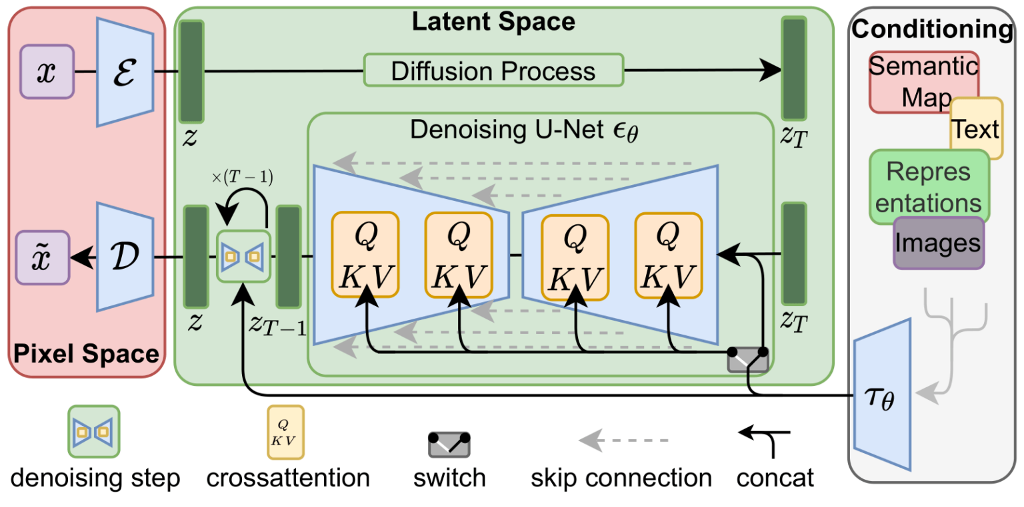
1. Diffusion model – Stable Diffusion
DDPM은 U-Net으로 직접적인 noise-to-pixel 복원하기 때문에 저화질의 이미지만 생성 가능하다
latent를 예측
https://xoft.tistory.com/32

Slide 6
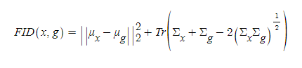
1. Diffusion model – Stable Diffusion
DDPM은 U-Net으로 직접적인 noise-to-pixel 복원하기 때문에 저화질의 이미지만 생성 가능하다
latent를 예측
https://xoft.tistory.com/32

Slide 7
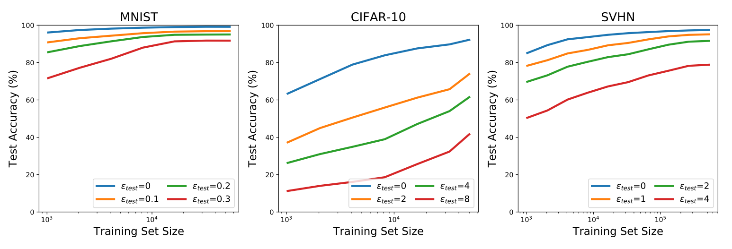
2. Diffusion-based AT
2018 – 더 많은 데이터가 좋은 AT 성능을 만듦을 보여줌 (이 때는 overfitting이 존재하는지 몰랐던 시기)
Adversarially Robust Generalization Requires More Data, NeurIPS 18’

Slide 8
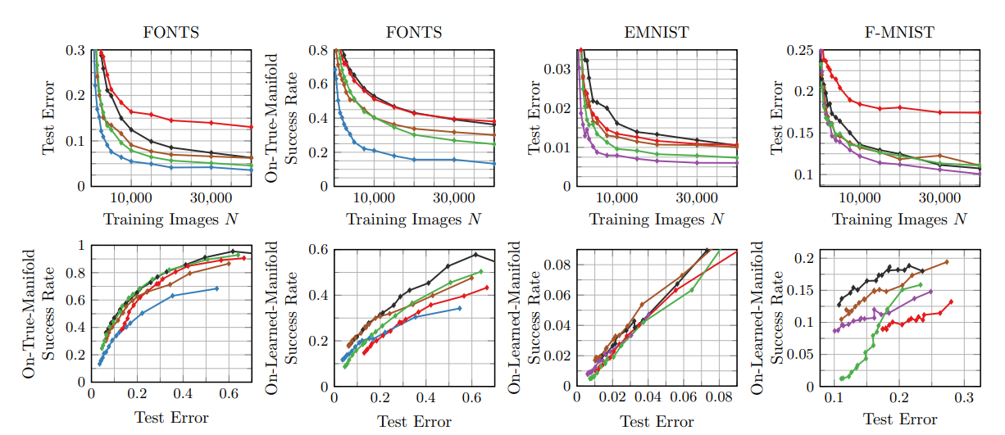
2. Diffusion-based AT
2018 – 더 많은 데이터가 좋은 AT 성능을 만듦을 보여줌 (이 때는 overfitting이 존재하는지 몰랐던 시기)
Disentangling adversarial robustness and generalization, CVPR 19

Slide 9
2. Diffusion-based AT
2019 – 외부 데이터를 도입함으로써 좋은 AT 성능을 만듦
- Using pre-training can improve model robustness and uncertainty, ICML 19’
CIFAR-10, CIFAR-100 + Downsampled ImageNet
- Unlabeled data improves adversarial robustness, arxiv 19’
CIFAR-10, CIFAR-100 + 500K unlabeled images sourced from 80 Million Tiny Images
- Are labels required for improving adversarial robustness?, NeurIPS 19’
CIFAR-10, CIFAR-100 + 500K unlabeled images sourced from 80 Million Tiny Images
- Robustness to adversarial perturbations in learning from incomplete data, NeurIPS 19’
MNIST, SVHN, CIFAR-10 데이터넷 내부에서 분할
- Adversarially robust generalization just requires more unlabeled data, arxiv 19’
MNIST, CIFAR-10

Slide 10
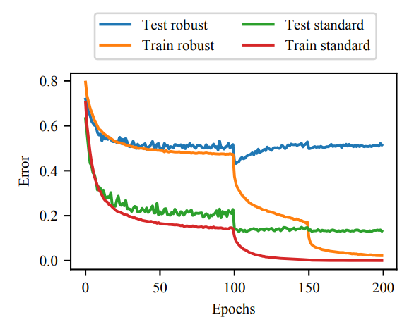
2. Diffusion-based AT
2020 – 처음으로 robust overfitting을 분석함
- Overfitting in adversarially robust deep learning, PMLR 20’
+ 이때 DDPM이 나옴

Slide 11
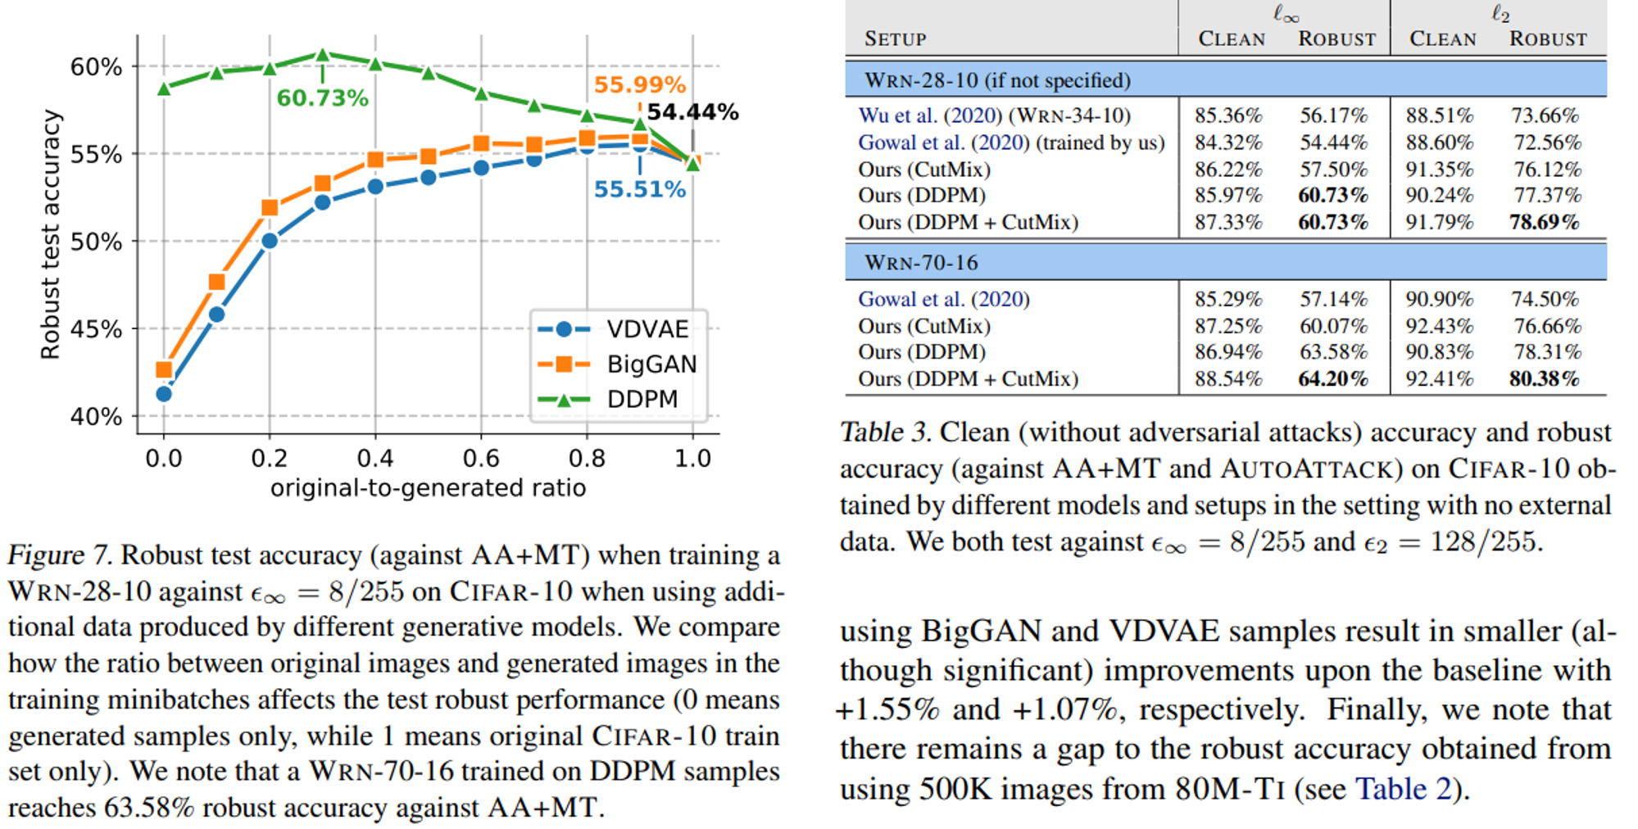
2. Diffusion-based AT
2021 – 처음으로 DDPM과 AT 결합 (이전에는 GAN based)
- Fixing data augmentation to improve adversarial robustness, NeurIPS 21’

Slide 12
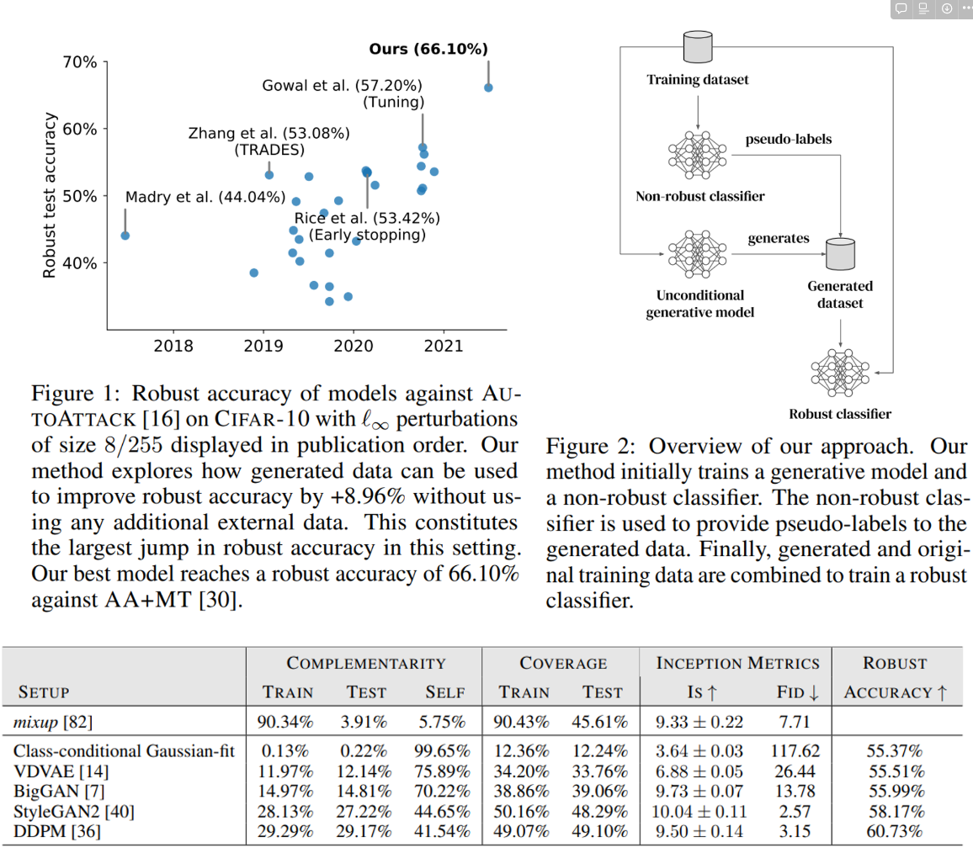
2. Diffusion-based AT
2021 – 처음으로 DDPM과 AT 결합 (이전에는 GAN based)
- Improving robustness using generated data, NeurIPS 21’
이전 논문 저자와 같은 저자

Slide 13
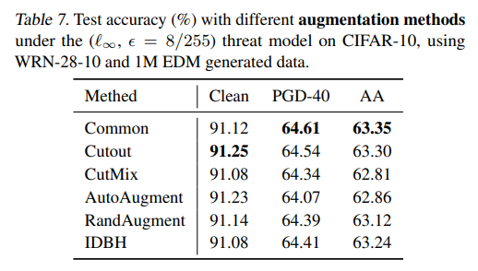
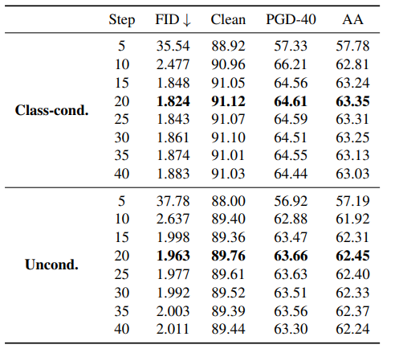
2. Diffusion-based AT
2022 – FID score SOTA diffusion model이 나옴
- Elucidating the design space of diffusion-based generative models, NeurIPS 22’
2023 – FID score 가 좋으면 좋을 수록 좋은 AT 성능을 낼 수 있을까?
- Better Diffusion Models Further Improve Adversarial Training, ICML 23’

Slide 14
3. Idea

